Slide 1
Database Management (DBAS32100)

Slide 2
Talend Data Integrator
Walid Belal

Slide 3
Download Talend open studio data integrator
Is a software that is used to move data between different data sources and implement simple data transformation, integration and cleansing tasks

Slide 4
Download Talend open studio data integrator
Create Table Student in your own schema. Student will have the following columns
Student_ID CHAR(8)
Student_GPA NUMBER(2,1)
Download the student csv file from slate

Slide 5
Install talend Open studio Data Integrator
Download it from this page
https://www.talend.com/products/data-integration/data-integration-open-studio/

Slide 6

Install talend Open studio Data Integrator
Double click on the downloaded executable file
Set the location of the application and click install

Slide 7
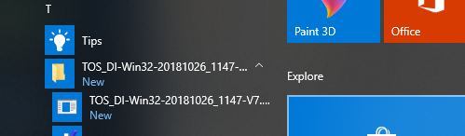
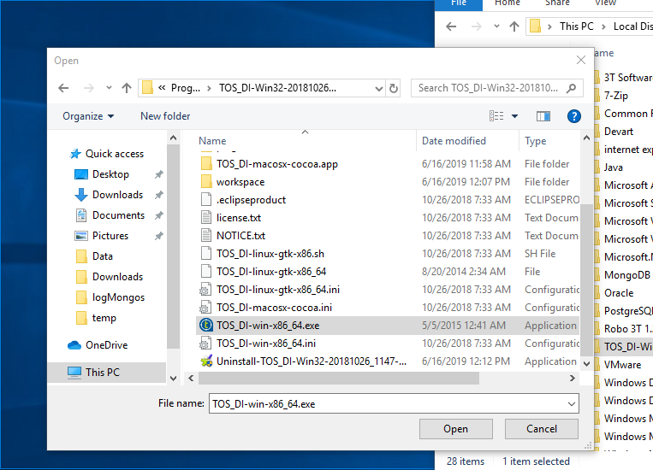
Open Talend Open Studio
From start menu scroll to TOS_DI
Expand TOS_DI and click on the app shortcut
You might get a message that it the shortcut can not locate the executable file. In this case click on browse and locate the executable file

Slide 8
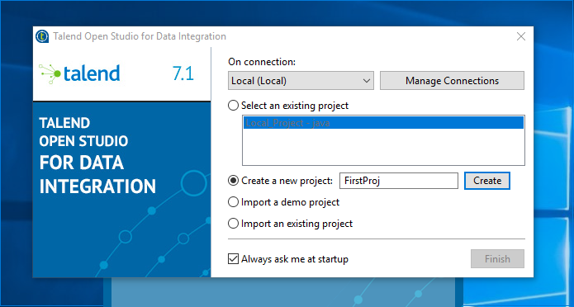
Open Talend Open Studio
A window will open. Choose create a new project and call it FirstProj
Click on Create then Finish

Slide 9
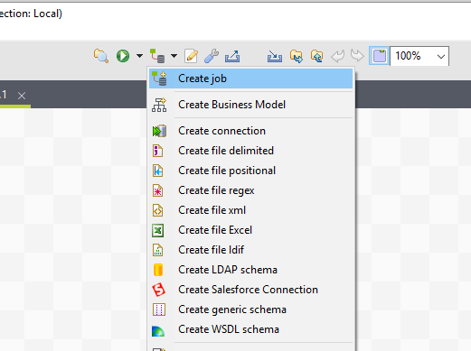
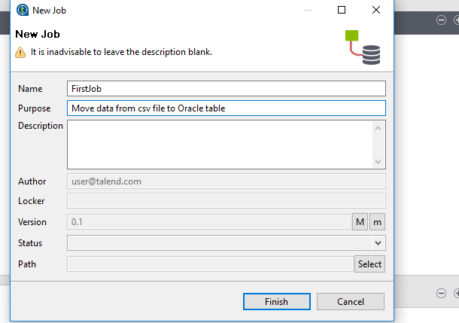
Create new Job
A job is a module of work in Talend Open Studio.

Slide 10
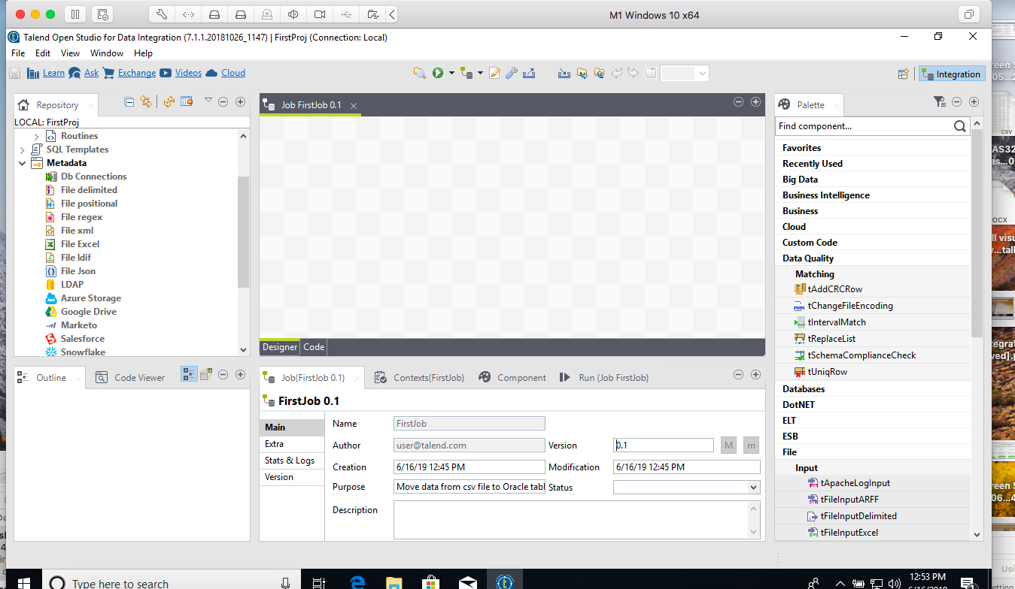
Jobs window. You will be making your flow here
Overview of talend Studio
Pallet contain the job design object
Metadata has predefined objects that you can reuse (e.g. database connections)
Properties of the selected object

Slide 11
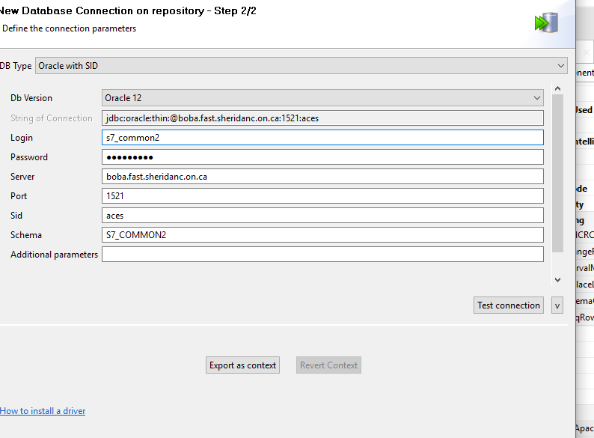
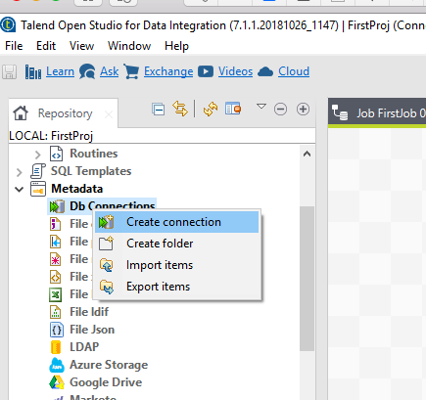
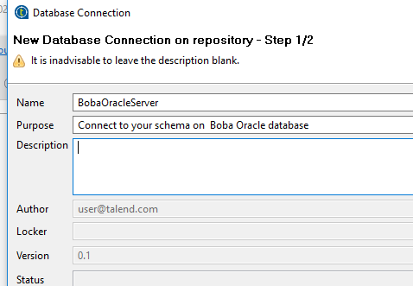
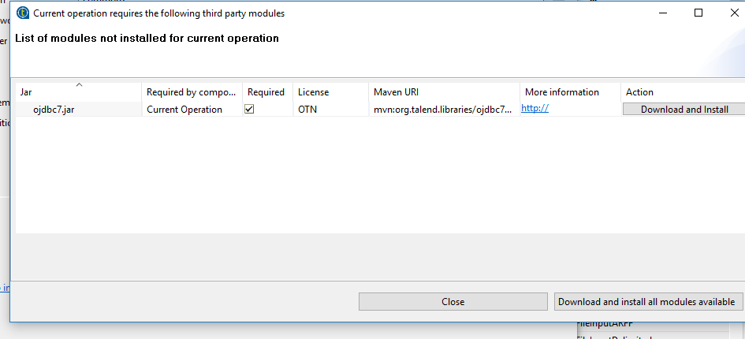
Create data connection to oracle in metadata
Make sure this is your oracle user and password
Test the connection to make sure it is working
You will be asked to install a driver. Download and install it

Slide 12
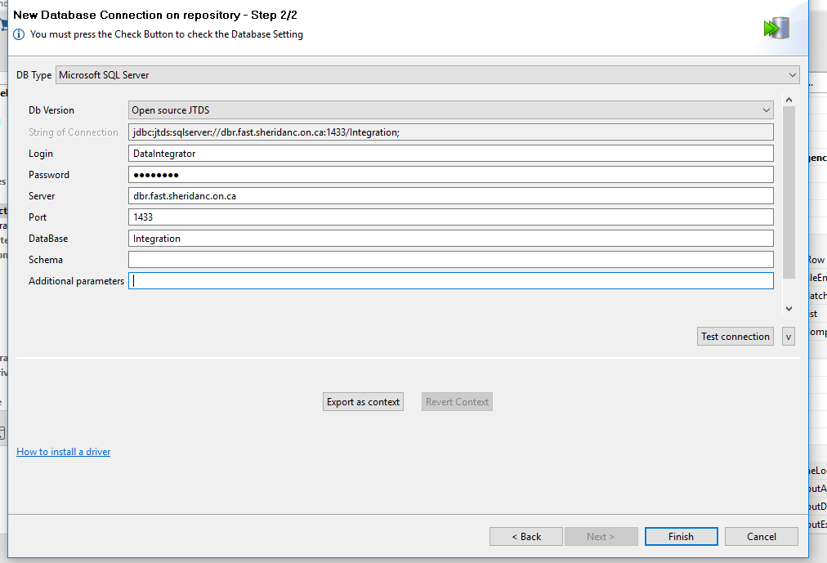
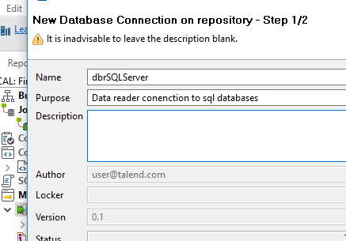
Create data connection to SQL-Server in metadata
The password is Sher1dan
Test the connection to make sure it is working

Slide 13
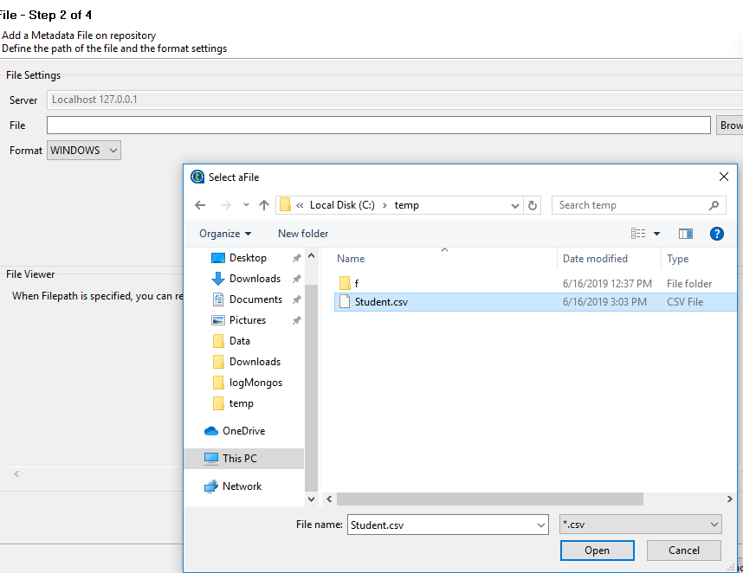
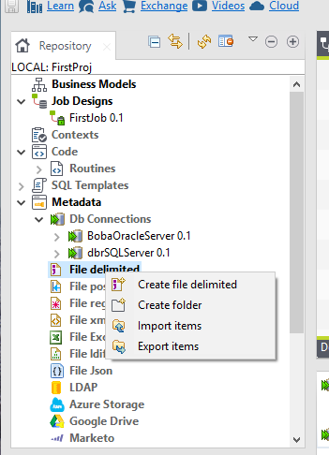
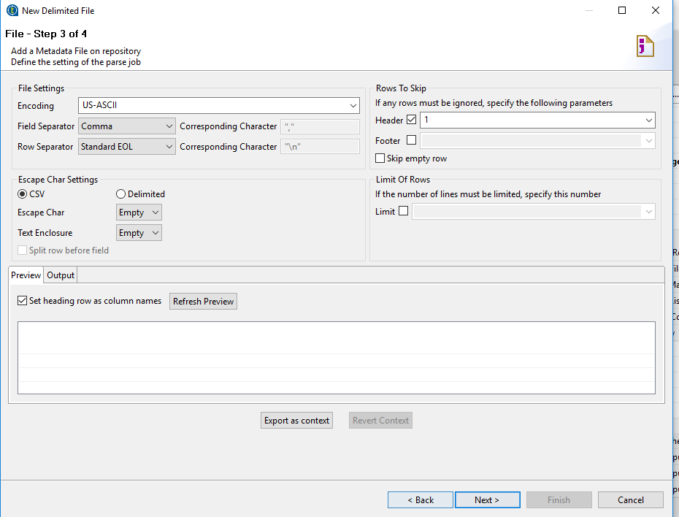
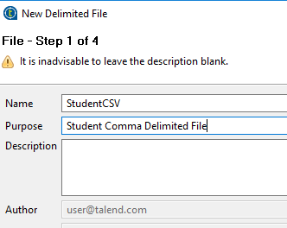
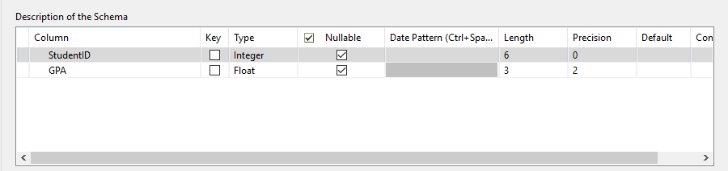
CONNECT TO CSV File
Choose windows format
Choose comma delimited
Check set heading as column name
Here is the mapping of the columns.

Slide 14
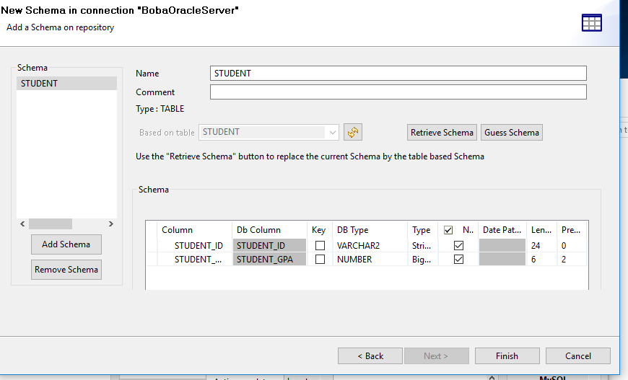
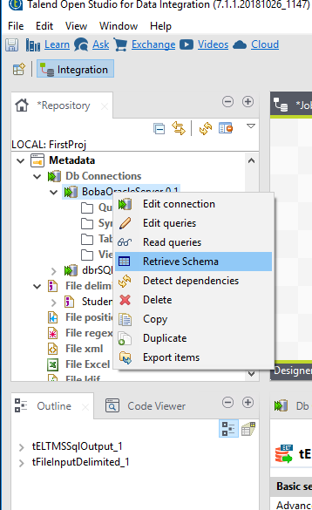
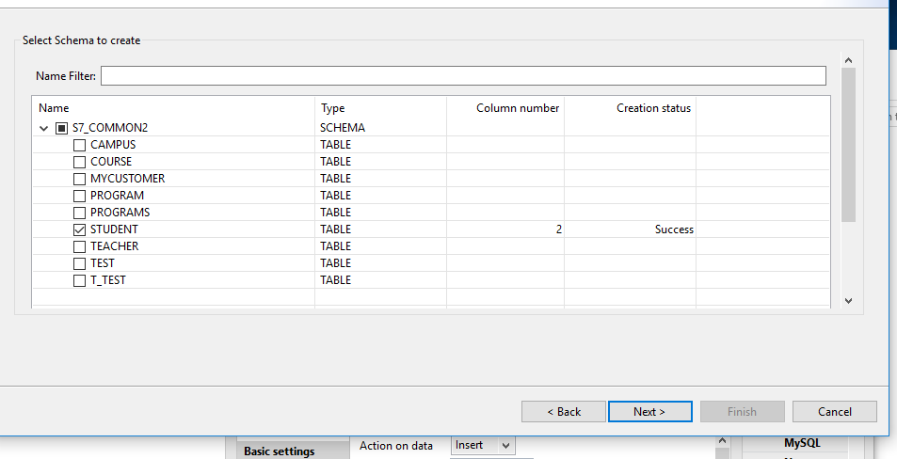
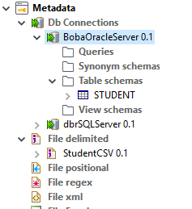
Create an oracle schema in metadata

Slide 15
Simple Mapping Job
This Job will take a comma delimited file as an input
Map the data to oracle table.
Then load the data to an oracle Table
Watch the accompanied video for instructions on how to make the mapping job

